Slide 1
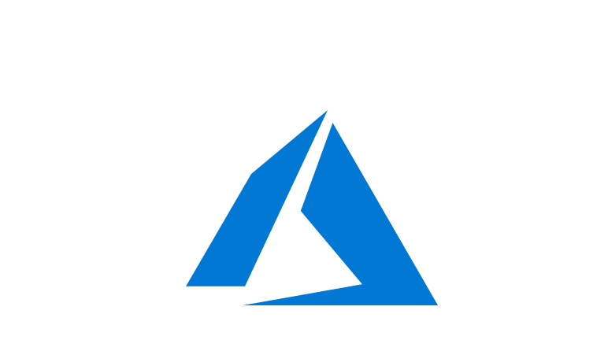
Course Outline
Module 1: Design a Compute Solution
Module 2: Design a Network Solution
Module 3: Design for Migration
Module 4: Design Authentication and Authorization
Module 5: Design Governance
Module 6: Design a Solution for Databases
Module 7: Select an Appropriate Storage Account
Module 8: Design Data Integration
Module 9: Design a Solution for Logging and Monitoring
Module 10: Design a Solution for Backup and Recovery
Module 11: Design for High Availability
Module 12: Design for Cost Optimization
Module 13: Design an Application Architecture
Module 14: Design Security for Applications
NOTE: The module order listed above aligns with the learning objectives described on the AZ-304: Microsoft Azure Architect Design certification page.

Slide 2
AZ-304: Microsoft Azure Architect Design

Slide 3
Module 4: Design Authentication and Authorization
Multi-Factor Authentication, Single-Sign On, Hybrid Identity, and B2B Integration

Slide 4
Learning Objectives
Tips for Identity and Access Management
Recommend a Solution for Multi-Factor Authentication
Five Steps for Securing Identity Infrastructure
Recommend a Solution for Single-Sign On (SSO)
Recommend a Solution for a Hybrid Identity
Recommend a Solution for B2B Integration
Recommend a Hierarchical Structure for Management Groups, Subscriptions, and Resource Groups
Lab: Managing Azure AD Authentication and Authorization
Module 4 Review Question

Slide 5

Tips for Identity and Access Management
Security Fundamentals

Slide 6

Tips for Identity and Access Management
This lesson covers the following tips for identity and access management:
Single Enterprise Directory
Synchronize Identity Systems
Use Cloud Provider Identity Source for Third Parties
Passwordless, or Multi-Factor Authentication for Admins
Block Legacy Authentication
Don’t Synchronize On-Premises Admin Accounts to Cloud Identity Providers
Use Modern Password Protection Offerings
Use Cross-Platform Credential Management

Slide 7
Single Enterprise Directory
For managing identities of full-time employees and enterprise resources
A single authoritative source for identities
Designate a single Azure Active Directory (Azure AD) instance directory
Centralized Identity Management
Notes:
Establish a single enterprise directory for managing identities of full-time employees and enterprise resources
A single authoritative source for identities increases clarity and consistency for all roles in IT and Security.
Using a single authoritative source allows teams to make changes in one place that effect everywhere.
Designate a single Azure Active Directory (Azure AD) instance directory as the authoritative source for corporate and organizational accounts.

Slide 8
Synchronize Identity Systems
Synchronize cloud identity with existing identity systems
Consistency of identities across cloud and on-premises reduces human errors
Teams managing resources in both environments need a consistent authoritative source
For Azure, synchronize Azure AD with an existing authoritative on premises Active Directory using Azure AD connect
Also required for Office 365 migration
See: Turn on Conditional Access
Notes:
Synchronize your cloud identity with existing identity systems.
Consistency of identities across cloud and on-premises reduces human errors.
Teams managing resources in both environments need a consistent authoritative source.
For Azure, synchronize Azure AD with an existing authoritative on premises Active Directory using Azure AD connect.
Also required for Office 365 migration

Slide 9
Block Legacy Authentication
Disable insecure legacy protocols for internet-facing services
Legacy authentication are password-centric and prime targets for password spraying, dictionary, or brute force attacks
Nearly 100% of all password spray attacks against Office 365 customers use legacy protocols
Legacy protocols lack account lockouts or back-off timers
For Azure and Azure AD-based accounts, configure Conditional Access to block legacy protocols.
Use metrics and logging data provided by authentication providers to determine users authenticating using older clients
Disable low-level protocols not in use
Provide ample notice and guidance to users ahead of upgrading from legacy authentication
Notes:
Best practice: Block legacy authentication protocols. Detail: Attackers exploit weaknesses in older protocols every day, particularly for password spray attacks. Configure Conditional Access to block legacy protocols.

Slide 10
Don’t Synchronize On-Premises Admin Accounts to Cloud Identity Providers
Don’t synchronize accounts with the highest privilege access to on-premises resources while synchronizing enterprise identity systems with cloud directories
Risk: Possible adversary gaining full control of on-premises assets following a successful compromise of a cloud account
Don’t synchronize accounts to Azure AD that have high privileges in your existing Active Directory
Note: Blocked by default in the Azure AD Connect configuration
Notes:
Best practice: Don’t synchronize accounts to Azure AD that have high privileges in your existing Active Directory instance. Detail: Don’t change the default Azure AD Connect configuration that filters out these accounts. This configuration mitigates the risk of adversaries pivoting from cloud to on-premises assets (which could create a major incident).

Slide 11
Use Modern Password Protection Offerings
Provide modern and effective protections for accounts that cannot go passwordless
Cloud identity providers apply anomaly detection to proactively notify companies when passwords have been compromised
Cloud identity providers validate whether a sign-in appears legitimate and not a malicious host

Slide 12
Use Cross-Platform Credential Management
Use a single identity provider for authenticating all platforms (Windows, Linux, and others) and cloud services
Deploying multiple identity solutions results in unenforceable password policies, passwords not reset after a breach, proliferation of passwords, and former employees retaining passwords after termination
Azure Active Directory can be used to authenticate Windows, Linux, Azure, Office 365, Amazon Web Services (AWS), Google Services, (remote access to) legacy on-premises applications, and third-party Software as a Service providers
Notes:
Use cross-platform credential management
https://docs.microsoft.com/en-us/azure/architecture/framework/security/identity#use-cross-platform-credential-management
Use a single identity provider for authenticating all platforms (Windows, Linux, and others) and cloud services.
A single identity provider for all enterprise assets will simplify management and security, minimizing the risk of oversights or human mistakes. Deploying multiple identity solutions (or an incomplete solution) can result in unenforceable password policies, passwords not reset after a breach, proliferation of passwords (often stored insecurely), and former employees retaining passwords after termination.
For example, Azure Active Directory can be used to authenticate Windows, Linux, Azure, Office 365, Amazon Web Services (AWS), Google Services, (remote access to) legacy on-premises applications, and third-party Software as a Service providers.

Slide 13
Recommend a Solution for Multi-Factor Authentication

Slide 14

Authentication vs Authorization
Authentication is the process of proving you are who you say you are
Microsoft identity platform implements the OpenID Connect protocol for handling authentication
Authorization is the act of granting an authenticated party permission to do something
Microsoft identity platform implements the OAuth 2.0 protocol for handling authorization
OAuth vs OpenID Connect:
OAuth is used for authorization and OpenID Connect (OIDC) is used for authentication
OpenID Connect is built on top of OAuth 2.0
You can both authenticate a user (using OpenID Connect) and get authorization to access a protected resource that the user owns (using OAuth 2.0) in one request
See: Authentication vs Authorization
Notes:
https://www.oauth.com/
https://openid.net/connect/
OAuth vs OpenID Connect: OAuth is used for authorization and OpenID Connect (OIDC) is used for authentication. OpenID Connect is built on top of OAuth 2.0, so the terminology and flow are similar between the two. You can even both authenticate a user (using OpenID Connect) and get authorization to access a protected resource that the user owns (using OAuth 2.0) in one request. For more information, see OAuth 2.0 and OpenID Connect protocols and OpenID Connect protocol.
OAuth vs SAML: OAuth is used for authorization and SAML is used for authentication. See Microsoft identity platform and OAuth 2.0 SAML bearer assertion flow for more information on how the two protocols can be used together to both authenticate a user (using SAML) and get authorization to access a protected resource (using OAuth 2.0).
OpenID Connect vs SAML: Both OpenID Connect and SAML are used to authenticate a user and are used to enable Single Sign On. SAML authentication is commonly used with identity providers such as Active Directory Federation Services (ADFS) federated to Azure AD and is therefore frequently used in enterprise applications. OpenID Connect is commonly used for apps that are purely in the cloud, such as mobile apps, web sites, and web APIs.

Slide 15
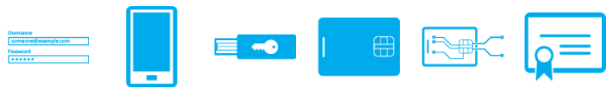
Reasons for Multi-Factor Authentication
Password complexity rules
Password expiration rules
Self-service password reset (SSPR)
Azure AD identity protection
Azure AD password protection
Azure AD smart lockout
Azure AD application proxy
Single sign-on (SSO)
Azure AD connect
Notes:
Password complexity rules. Forces users to generate hard(er)-to-guess passwords.
Password expiration rules. Forces users to change their passwords on a periodic basis.
Self-service password reset (SSPR). Allows users to self-serve and reset their password if they have forgotten it without involving an IT department.
Azure AD Identity Protection. Protects identities by using risk-based policies that automatically respond to risky behaviors… can automatically block or initiate remediations.
Azure AD password protection. Blocks commonly used and compromised passwords via a globally banned-password list.
Azure AD smart lockout. Locks out malicious hackers trying to guess user passwords or using brute-force method.
Azure AD Application Proxy. Provisions security-enhanced remote access to on-premises web applications.
Single sign-on (SSO). Access applications using a single sign-on.
Azure AD Connect. Create and manage a single identity for each user across a hybrid enterprise.

Slide 16
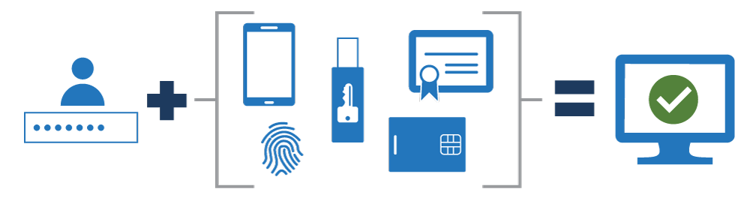
How Multi-Factor Authentication Works
Something you know
Something you possess
Something you are
Notes:
MFA falls into three categories:
Something you know - which might be a password or the answer to a security question.
Something you possess - which might be a mobile app that receives a notification or a token-generating device.
Something you are - which typically is a biometric property, such as a fingerprint or face scan used on many mobile devices.

Slide 17
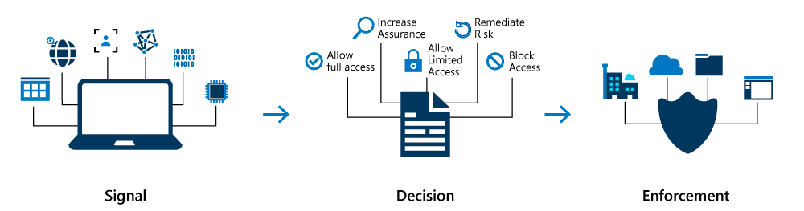
Conditional Access
Conditional Access is the tool used by Azure Active Directory to bring signals together, to make decisions, and enforce organizational policies
Notes:
Conditional Access policies are if-then statements… ie, A payroll manager wants to access the payroll application and is required to perform multi-factor authentication to access it.

Slide 18
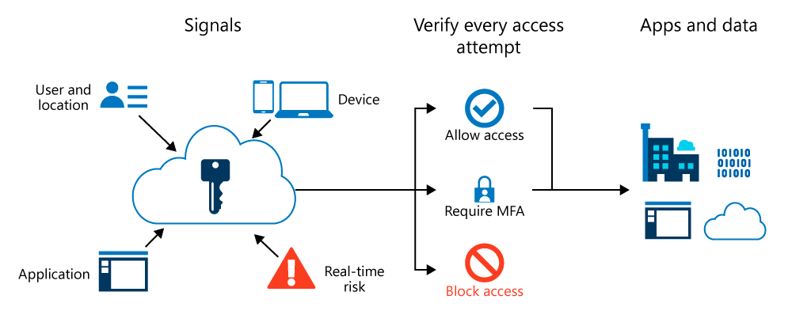
Conditional Access and Azure Multi-Factor Authentication

Slide 19
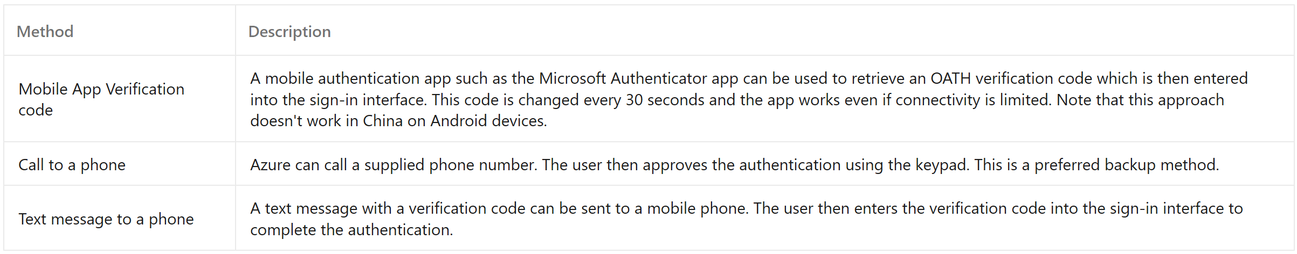
Plan for MFA Deployment
Azure MF policies
Azure Multi-factor Authentication is enforced with Conditional Access policies. Conditional Access policies are IF-THEN statements
IF a user wants to access a resource, THEN they must complete an action
IF a specific cloud application is accessed
IF a user is accessing a specific network
IF a user is accessing a specific client application
IF a user is registering a new device

Slide 20
Five Steps for Securing Identity Infrastructure

Slide 21
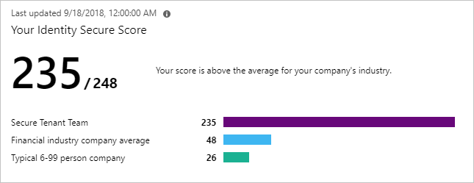
Five Steps to Securing Identity Infrastructure
Five-step checklist to protecting against cyber-attacks by using Azure AD
Step 1: Strengthen credentials
Step 2: Reduce attack surface
Step 3: Automate threat response
Step 4: Utilize cloud intelligence
Step 5: Enable end-user self-service

Slide 22
Step 1 - Strengthen Credentials
Use strong authentication
Ban common passwords and turn off traditional complexity, and expiration rules
Protect against leaked credentials
Take advantage of intrinsically secure, easier to use credentials
See: Step 1 - Strengthen your credentials
Notes:
Use strong authentication
Use one-click enablement with Azure AD Security Defaults.
Ban common passwords and turn off traditional complexity, and expiration rules.
Azure AD's dynamic banned password feature uses current attacker behavior to prevent users from setting passwords that can easily be guessed.
Protect against leaked credentials
See the Users with leaked credentials report in the Azure AD management for username and password pairs warnings.
For on-premises outage, switch over to using cloud authentication with password hash sync.
Take advantage of intrinsically secure, easier to use credentials
Use Windows Hello to replace passwords with strong two-factor authentication; a user credential that is tied securely to a device and uses a biometric or PIN.

Slide 23
Step 2 - Reduce Attack Surface
Block invalid authentication entry points
Restrict user consent operations
Implement Azure AD Privileged Identity Management
Identify and manage users assigned to administrative roles
Establish rules for multi-factor authentication
Understand unused or excessive privilege roles
See: Step 2 - Reduce your attack surface
Notes:
Block invalid authentication entry points
Using the assume breach mentality, you should reduce the impact of compromised user credentials when they happen.
Restrict user consent operations
Disable future user consent operations to help reduce your surface area and mitigate this risk.
When end-user consent is disabled, previous consent grants will be honored but all future consent operations must be performed by an administrator.
Implement Azure AD Privileged Identity Management
Use PIM to minimized account privileges to:
Identify and manage users assigned to administrative roles.
Understand unused or excessive privilege roles you should remove.
Establish rules to make sure privileged roles are protected by multi-factor authentication.
Establish rules to make sure privileged roles are granted only long enough to accomplish the privileged task.

Slide 24
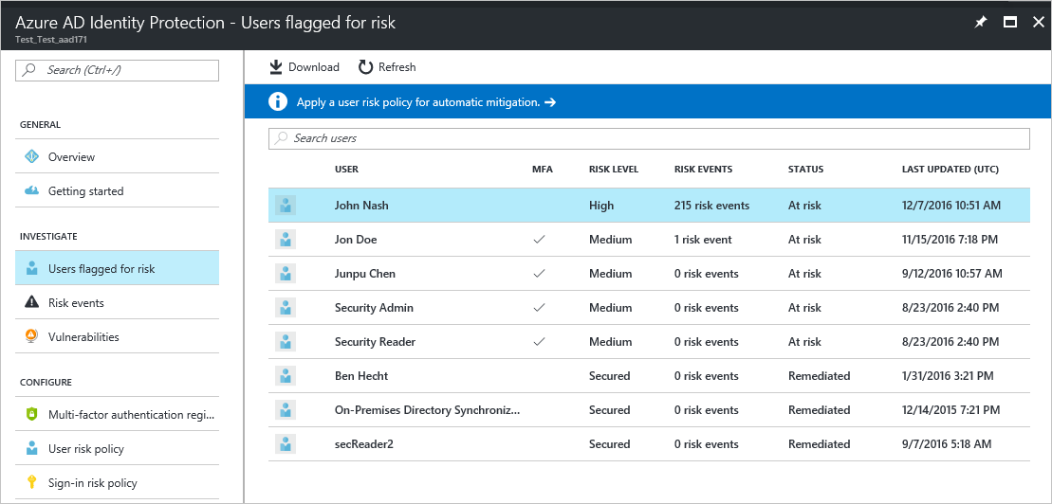
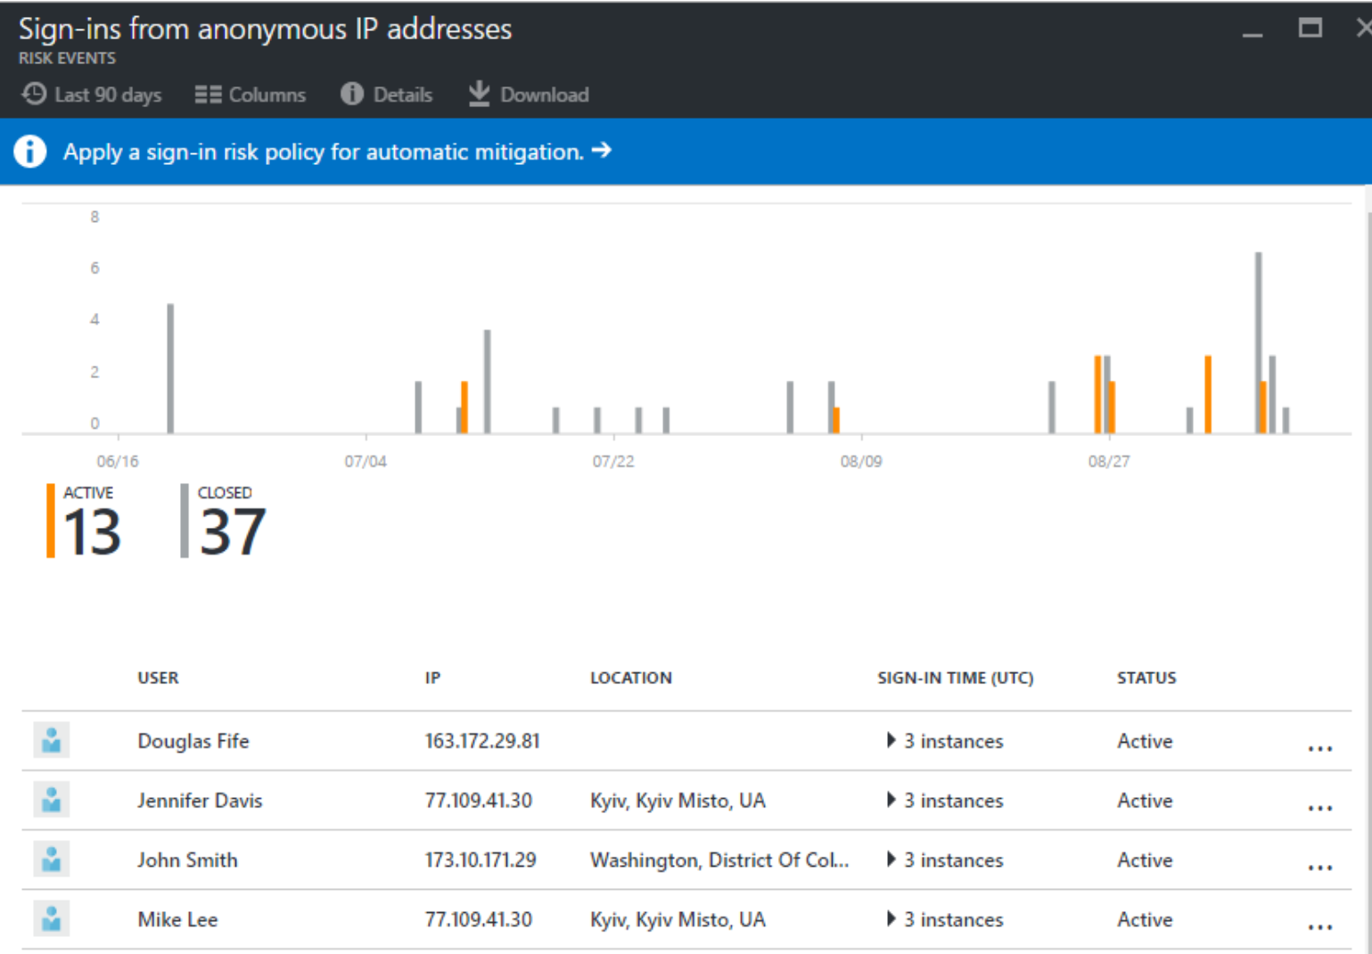
Step 3 - Automate Threat Response
Implement user risk security policy using Azure AD Identity Protection
Implement sign-in risk policy using Azure AD Identity Protection
See: Step 3 - Automate threat response

Slide 25
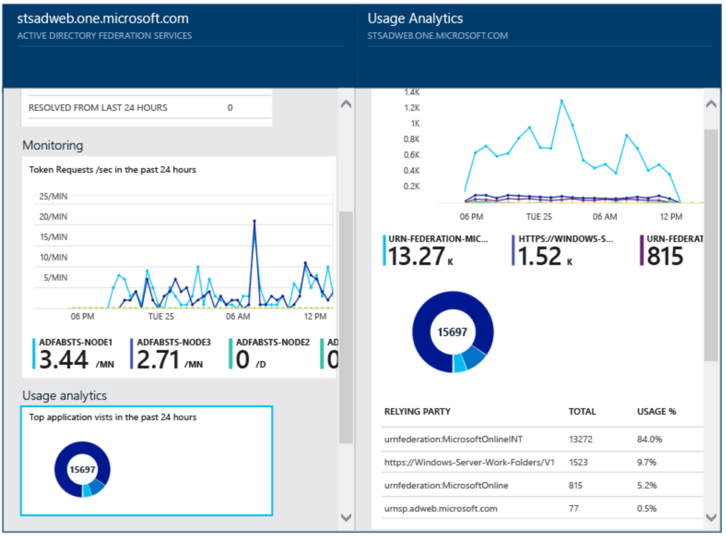
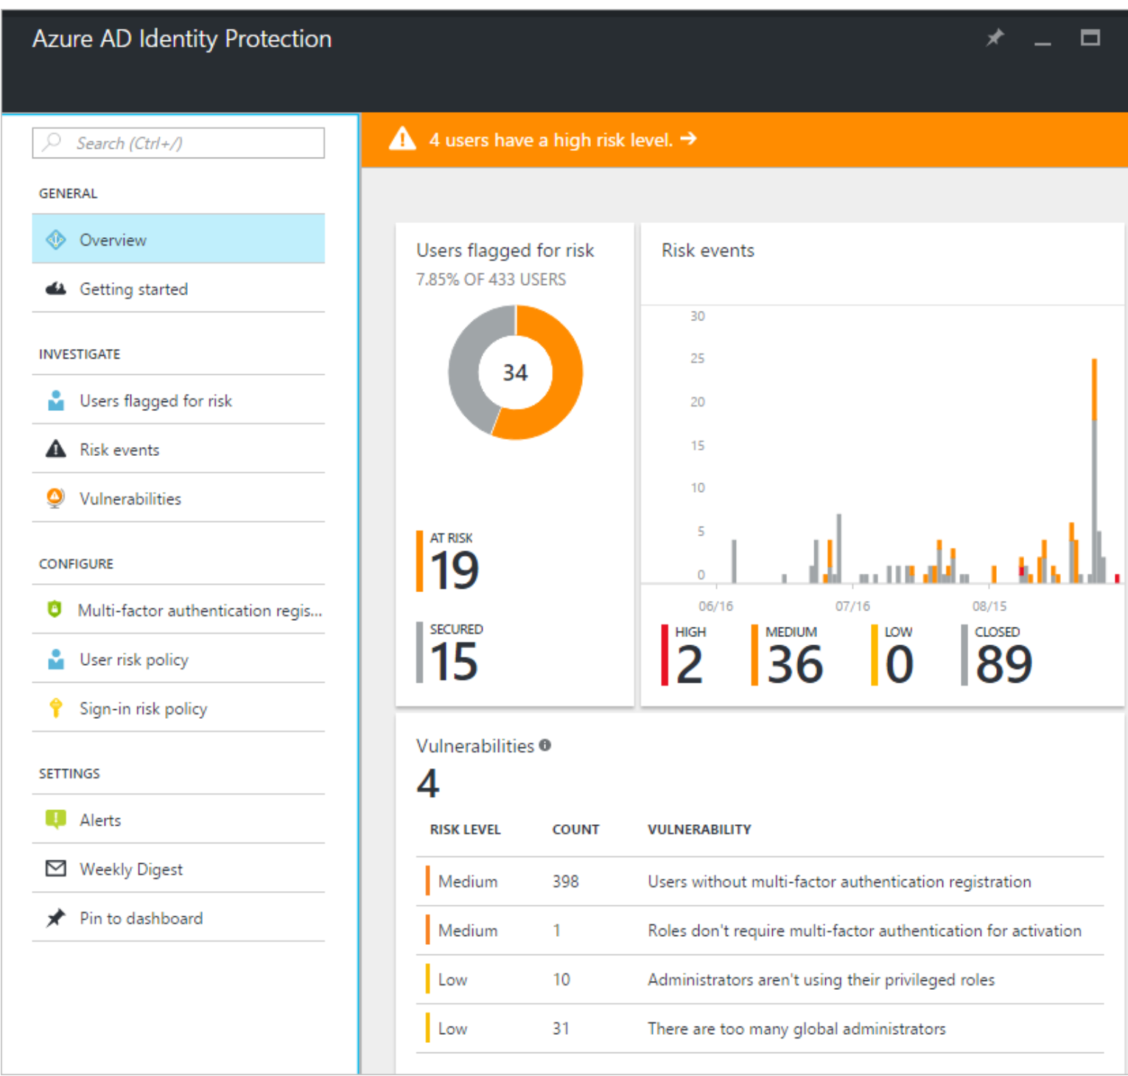
Step 4 - Utilize Cloud Intelligence
Monitor Azure AD Connect Health in hybrid environments
Details, resolution steps
Usage analytics
Performance monitoring and reports
Monitor Azure AD Identity Protection events
Risky sign-in reports
Risky user reports
See: Step 4 - Utilize cloud intelligence
Notes:
Monitor Azure AD Connect Health in hybrid environments
Azure AD Connect Health delivers alerts with details, resolution steps, and links to related documentation
Usage analytics for several metrics related to authentication traffic
Performance monitoring and reports.
Monitor Azure AD Identity Protection events
Azure AD Identity Protection provides two reports:
Risky sign-in reports will surface user sign-in activities.
Risky user reports will surface user accounts that may have been compromised, such as leaked credential that was detected or the user signed in from different locations.

Slide 26
Step 5 - Enable End-User Self Service
Self-service password reset
Self-service group and application access
Azure AD access reviews
See: Step 5 - Enable end-user self-service
Notes:
Implement self-service password reset
Azure AD SSPR includes detailed reporting that tracks when users have reset their passwords, along with notifications to alert you to misuse or abuse.
Implement self-service group and application access
Self-service group management enables group owners to manage their own groups, without needing to be assigned an administrative role.
Delegate to non-administrators the ability to configure their own access packages for groups, Teams, applications, and SharePoint Online sites.
Implement Azure AD access reviews
Manage access package and group memberships, access to enterprise applications, and privileged role assignments using access reviews.

Slide 27
Recommend a Solution for Seamless Single-Sign On (SSO)

Slide 28
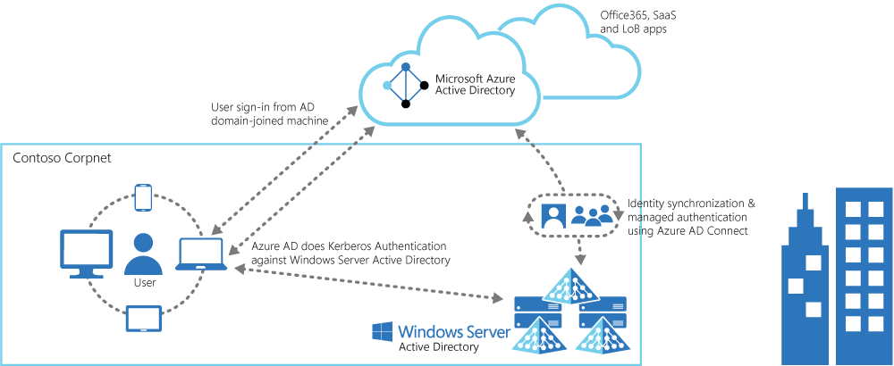
Azure Active Directory Seamless Single Sign-On (SSO)
Sign-in username can be either the on-premises default username (userPrincipalName) or another attribute configured in Azure AD Connect (Alternate ID) method but cannot be used with ADFS
IF SSO fails, use password at sign-in page
Sign-in/out of other accounts
Enabled via Azure AD Connect
Sample list of applications included with Azure AD

Slide 29
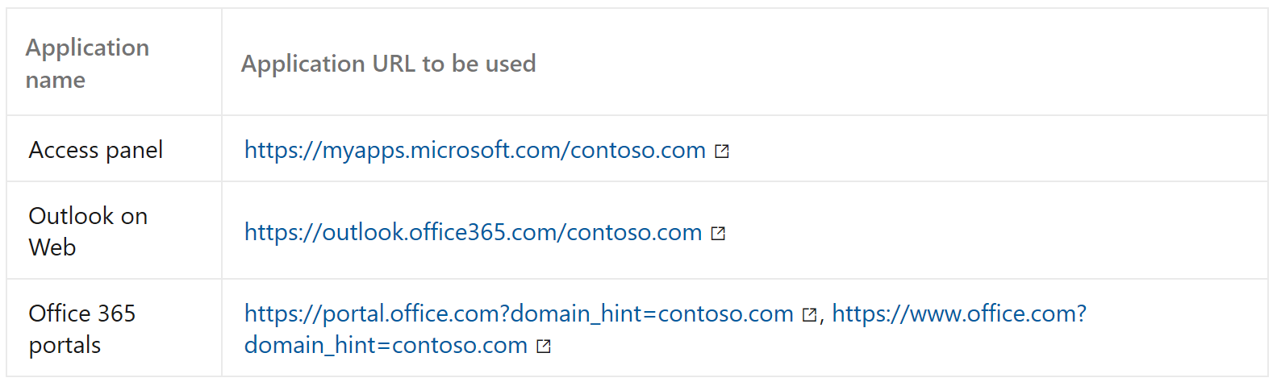
Considerations - Azure AD Seamless Single Sign-On
Can be combined with Password Hash or Pass-through Authentication
Azure AD Join provides SSO for devices registered with Azure AD
Applications using domain_hint or login_hint parameter capability of Seamless SSO:
Notes:
Seamless SSO can be combined with either the Password Hash or Pass-through Authentication sign-in methods
Seamless SSO is only available in the worldwide instance of Azure AD and not Microsoft Azure Germany cloud or Microsoft Azure Government cloud.
Azure AD Join provides SSO to users if their devices are registered with Azure AD. These devices don't necessarily have to be domain-joined.
Applications using domain_hint or login_hint parameter capability of Seamless SSO:

Slide 30
Recommend a Solution for a Hybrid Identity

Slide 31
Considerations - Multi-Factor Authentication for Hybrid Identity
Define the technical requirements for MFA
Define the MFA strategy
Define requirements for rolling out MFA
Define technical requirements for enabling users for MFA
Notes:
Define the technical requirements for setting up and enabling users for MFA:
Is your company trying to secure Microsoft apps?
How are apps published?
Does your company provide remote access to allow employees to access on-premises apps?
Define the MFA strategy.
Where are the users going to be located?
Can they be located anywhere?
Does your company want to establish restrictions according to the user’s location?
Define requirements for rolling out MFA.
Are the users familiar with multi-factor authentication?
Will some uses be required to provide additional authentication?
Will the users require training on how to setup and implement multi-factor authentication?
Define technical requirements for enabling users for MFA.
Does your company need to protect privileged accounts with MFA?
Does your company need to enable MFA for certain application for compliance reasons?
Do you need to have MFA always enabled or only when the users are logged outside of your corporate network?

Slide 32
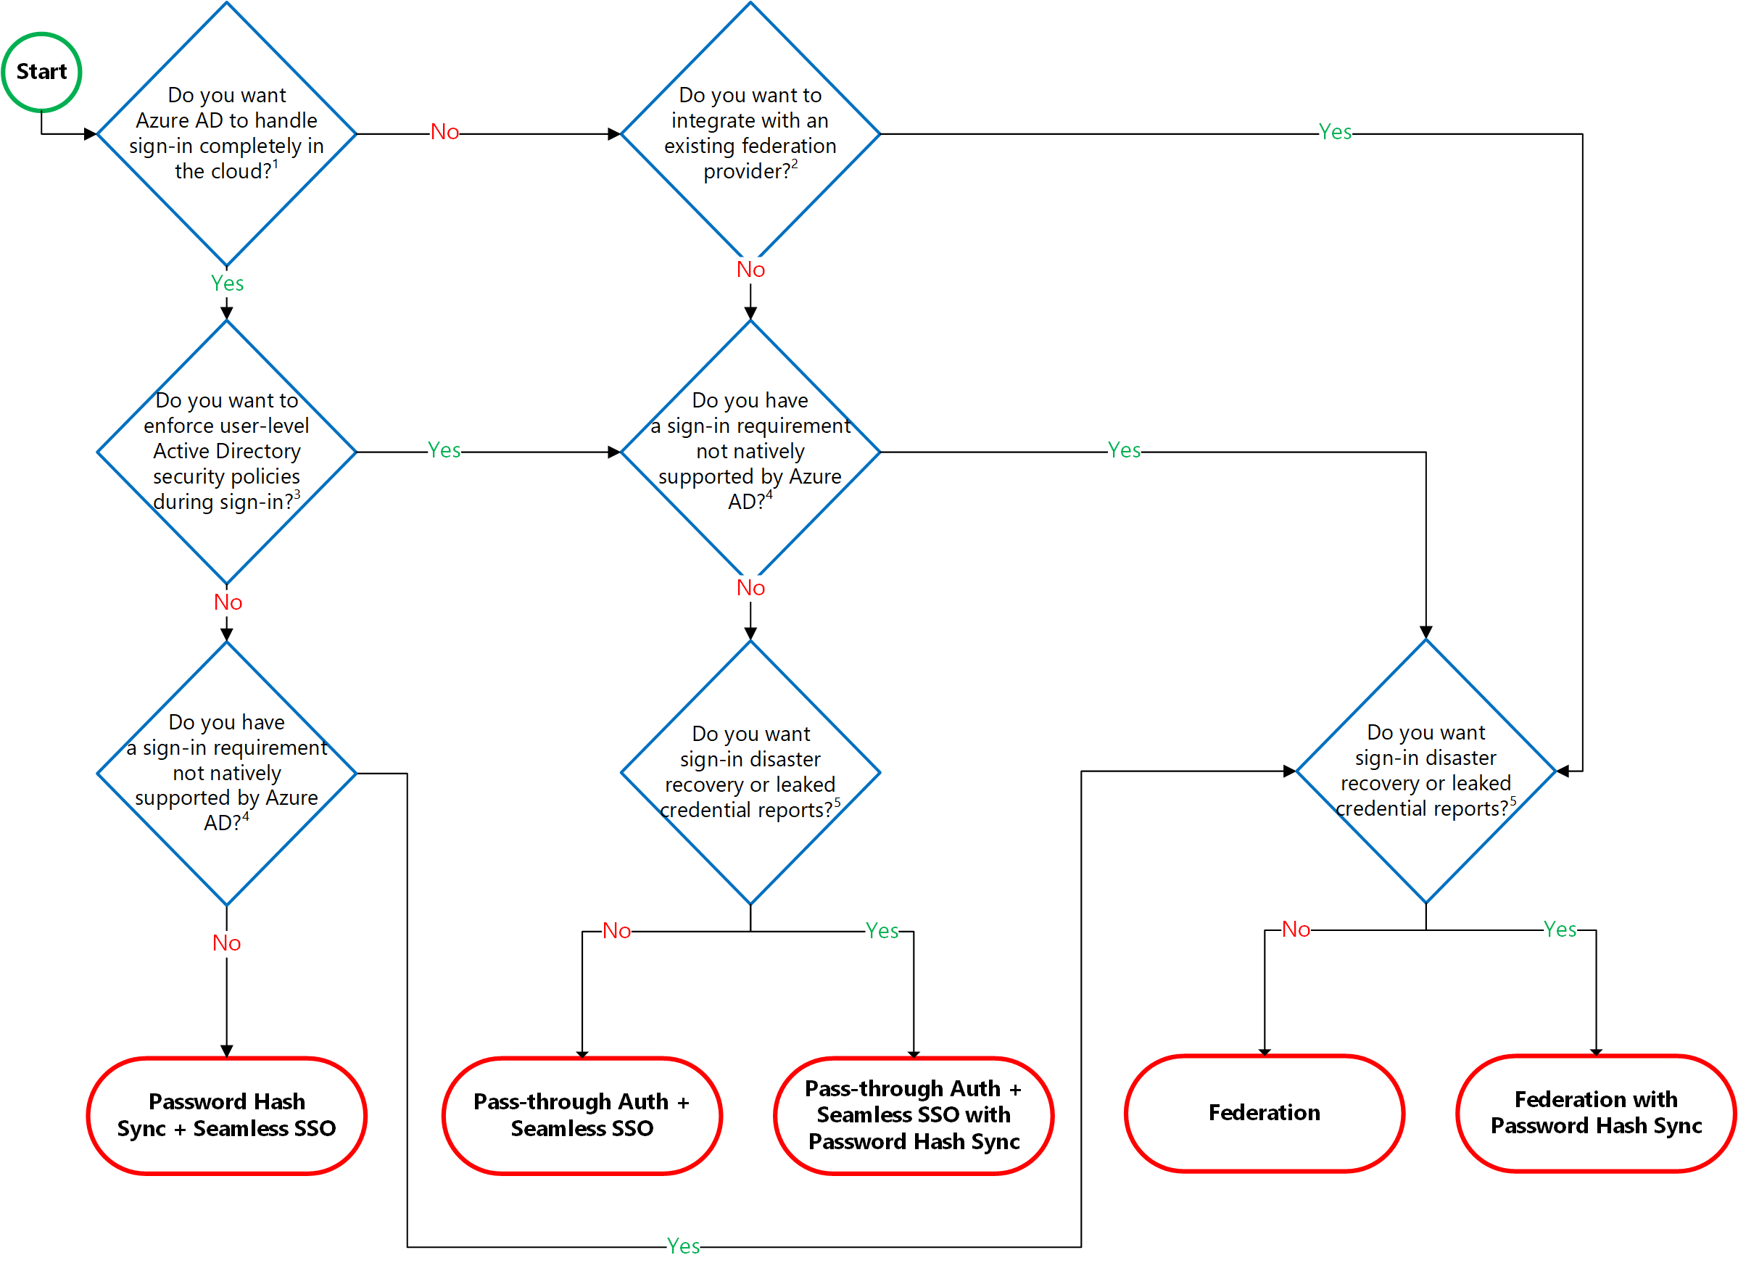
Hybrid Identity Decision Tree
See: Choose the right authentication method for your Azure Active Directory hybrid identity solution

Slide 33
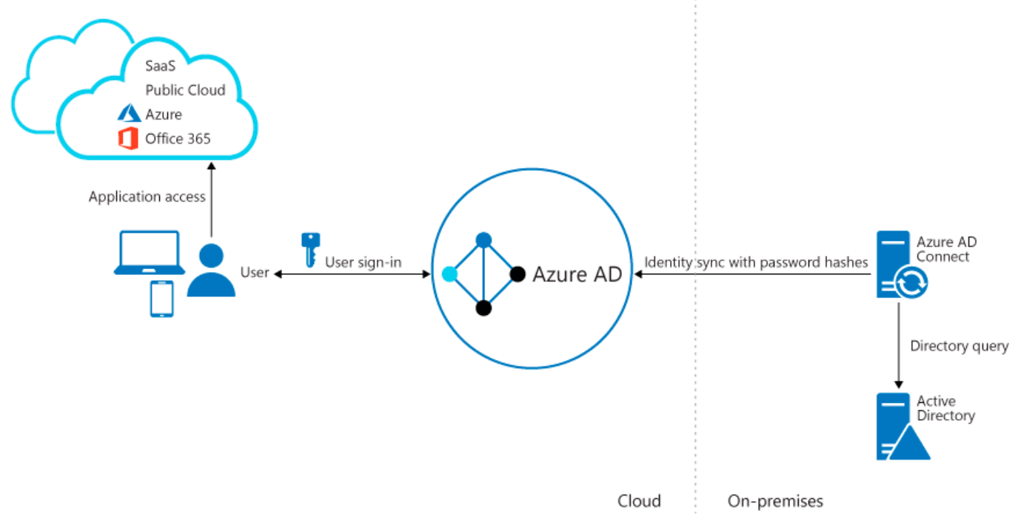
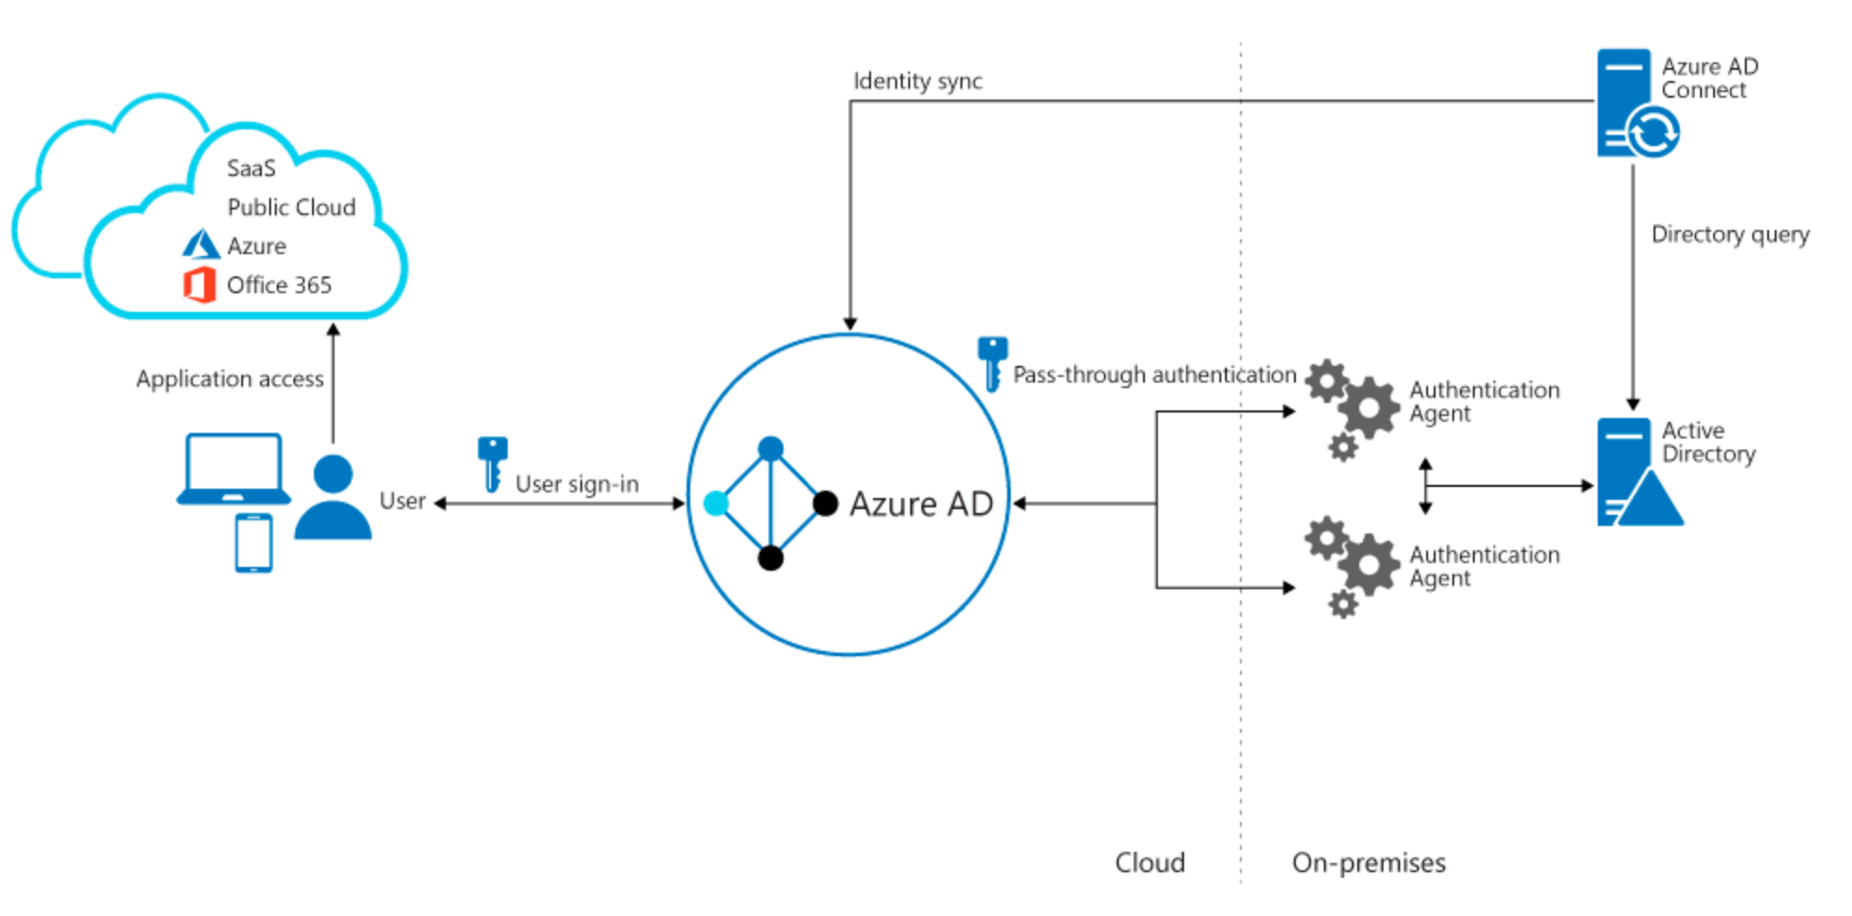
Authentication Architecture
Simplicity of a password hash synchronization solution
Agent requirements of pass-through authentication, using two agents for redundancy

Slide 34
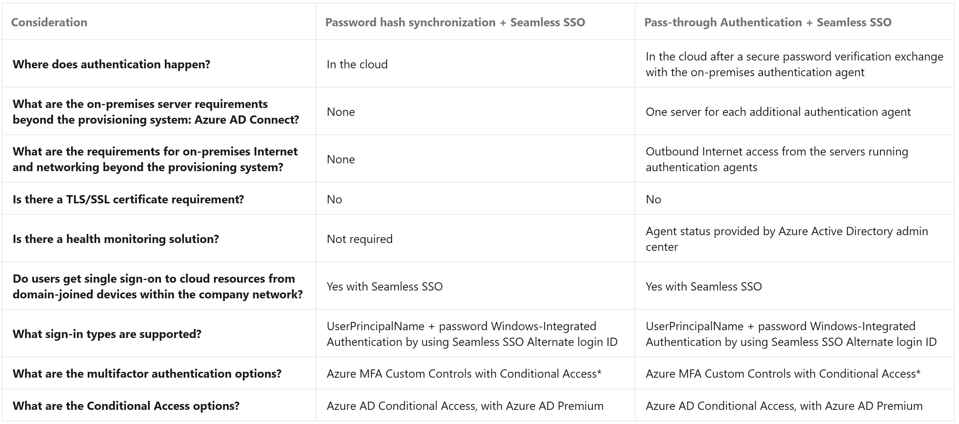
Comparing Authentication Methods
Notes:
https://docs.microsoft.com/en-us/azure/active-directory/hybrid/choose-ad-authn#comparing-methods

Slide 35
Recommend a Solution for B2B Integration

Slide 36
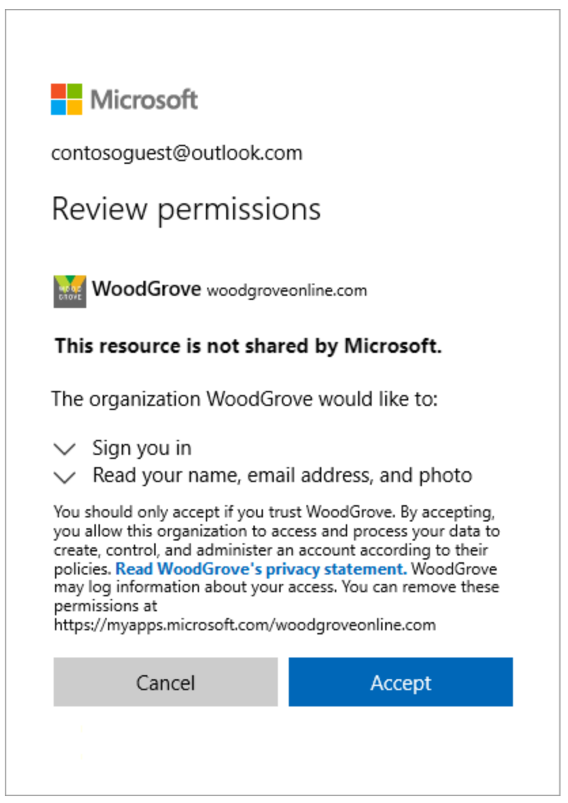
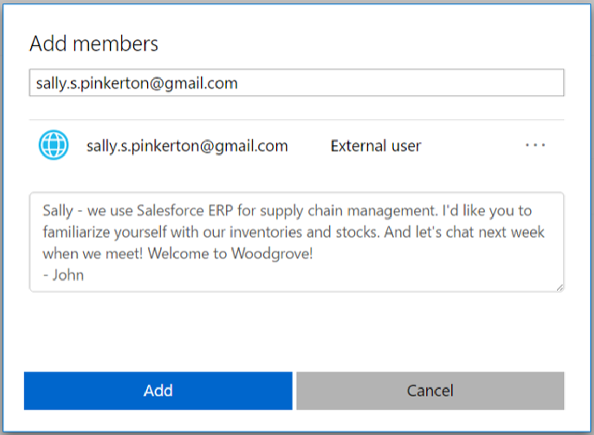
Azure Active Directory B2B
Partners use their own identity management solution
Invite guest users with an invitation
See: What is guest user access in Azure Active Directory B2B?
Notes:
Azure AD B2B
The partner uses their own identities and credentials.
You don't need to manage external accounts or passwords.
You don't need to sync accounts or manage account lifecycles.
Invite guest users with an invitation
Guest users sign-in to your apps and services with their own work, school, or social identities.
If the guest user doesn’t have a Microsoft account or an Azure AD account, one is created for them when they redeem their invitation.
Invite guest users using the email identity of their choice.
Send a direct link to an app or send an invitation to the guest user's own Access Panel.
Guest users follow redemption steps to sign in.

Slide 37
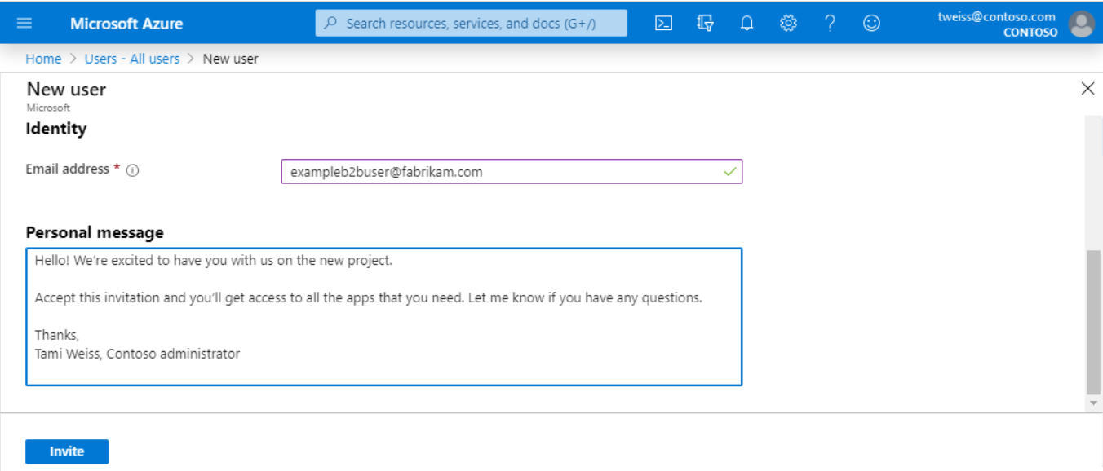
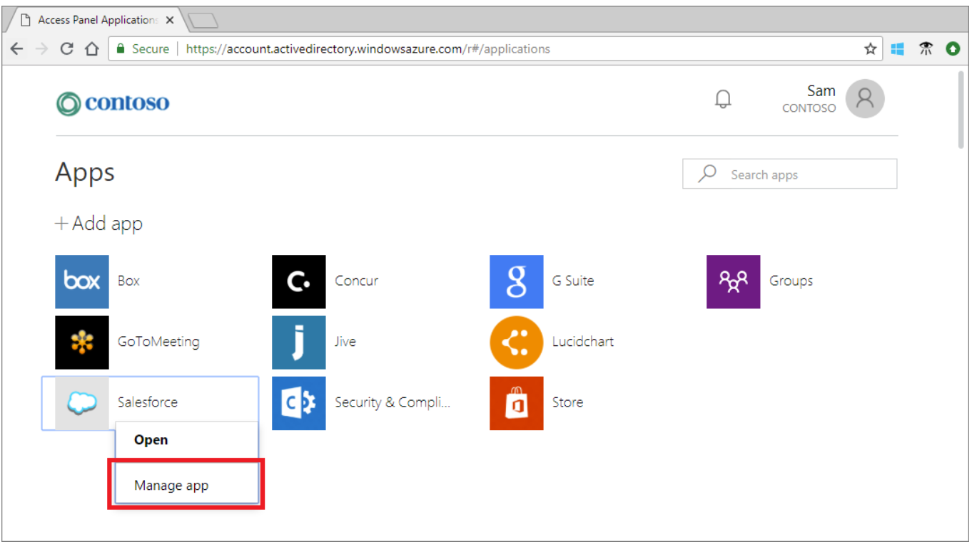
Add Guest Users in the Azure AD Portal
Add guest users in the Azure portal
Create a new guest user
The guest user receives
Guest users assigned to app or group
Allow application/group owners to manage their guest users
Administrators – self-service app and group management
Non-administrators – Use Access Panel to add guest users
Notes:
Add guest users in the Azure portal
Create a new guest user in Azure AD.
The guest user immediately receives a customizable invitation that lets them sign into their Access Panel.
Guest users in the directory can be assigned to apps or group.
Allow application/group owners to manage their guest users
Administrators set up self-service app and group management.
Non-administrators use their Access Panel to add guest users to applications or groups.

Slide 38
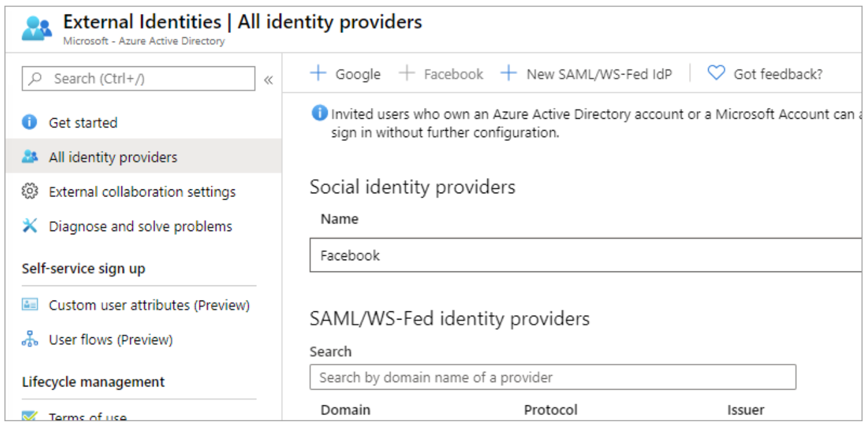
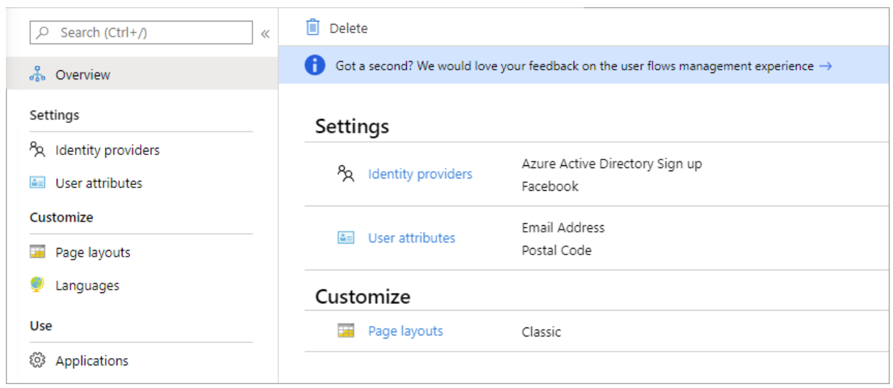
Integrate with Identity Providers
Set up Federation with Identity Providers
Create a Self-Service Sign-Up User Flow

Slide 39
Recommend a Hierarchical Structure for Management Groups, Subscriptions, and Resource Groups

Slide 40
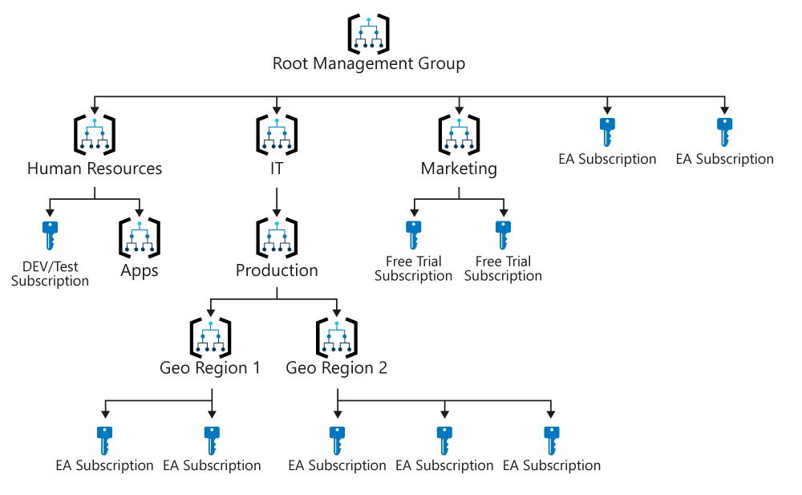
Hierarchy of Management Groups and Subscriptions
Facts about management groups:
10,000 / Subscriptions
7 levels (including root)
1 or many
Single hierarchy
Notes:
Facts about management groups
10,000 management groups in a single directory.
A management group tree up to six levels of depth—doesn't include the Root level or the subscription level.
Each management group and subscription can only support one parent.
Each management group can have many children.
All subscriptions and management groups are within a single hierarchy in each directory.

Slide 41
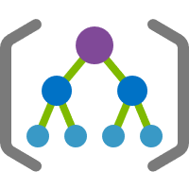
Root Management Group
Default ID: Azure Active Directory ID
Owner or Contributor
Cannot be moved or deleted
All resources in the directory fold up to the root management group
Default group for new subscriptions.
Can be seen by all customers
See: Root management group for each directory
Notes:
By default, the root management group's display name is Tenant root group. The ID is the Azure Active Directory ID.
To change the display name, your account must be assigned the Owner or Contributor role on the root management group.
The root management group can't be moved or deleted.
All subscriptions and management groups fold up to the one root management group within the directory.
All resources in the directory fold up to the root management group for global management.
New subscriptions are automatically defaulted to the root management group when created.
All Azure customers can see the root management group.

Slide 42
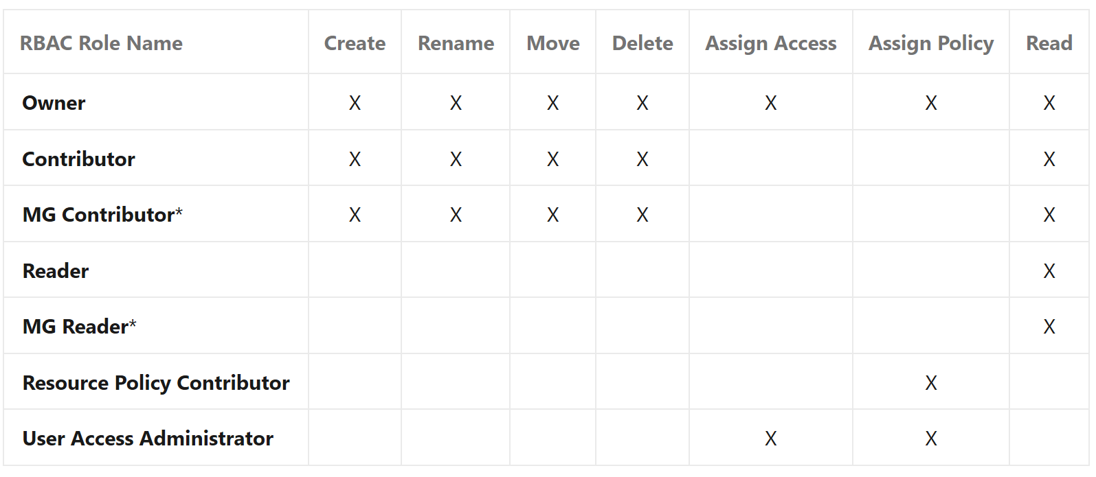
Management Group Access
RBAC
Hierarchical permissions
Any RBAC role can be assigned to a management group
Notes:
https://docs.microsoft.com/en-us/azure/governance/management-groups/overview#management-group-access

Slide 43
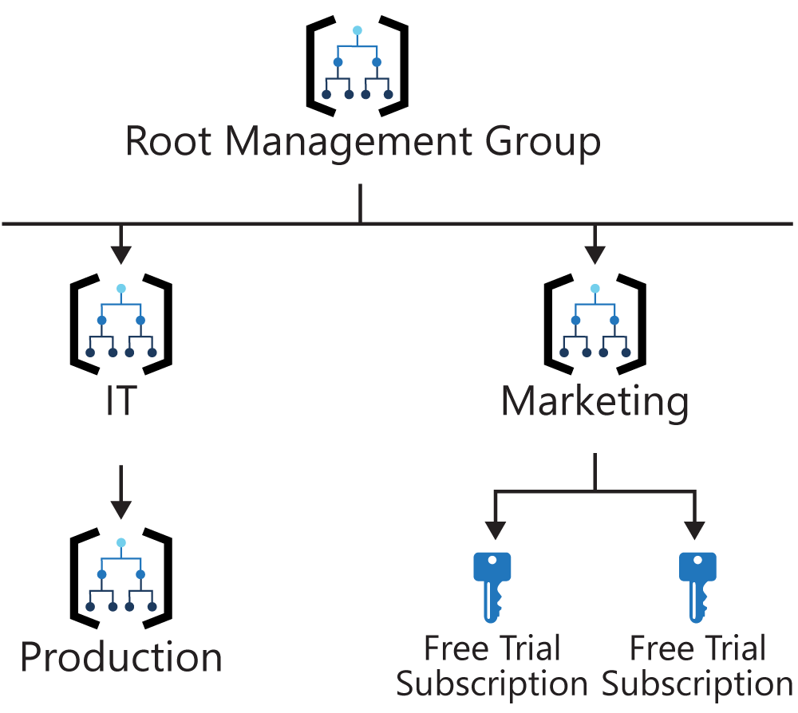
Custom RBAC Role Definition and Assignment
Scenario: A custom role defined on the Marketing management group.
The custom role is then assigned on two free trial subscriptions
Attempt to move one of those subscriptions to be a child of the Production management group
The move breaks the path from subscription role assignment to the Marketing management group role definition
You'll receive an error saying the move isn't allowed since it will break this relationship
What are the options for fixing this scenario?
Notes:
Scenario: A custom role defined on the Marketing management group.
The custom role is then assigned on two free trial subscriptions.
Attempt to move one of those subscriptions to be a child of the Production management group—the move breaks the path from subscription role assignment to the Marketing management group role definition.
You'll receive an error saying the move isn't allowed since it will break this relationship.
What are the options for fixing the scenario?

Slide 44
Lab

Slide 45
Lab: Managing Azure AD Authentication and Authorization
After completing this lab, you will be able to:
Deploy an Azure VM hosting an AD DS domain controller
Create and configure an Azure AD tenant
Integrate an AD DS forest with an Azure AD tenant

Slide 46
Module 4 Review Questions

Slide 47
Online Role-based training resources: Microsoft Learn https://docs.microsoft.com/en-us/learn/

Slide 48
Thank you.

